Slide 1
§10.3: Graph Representations & Isomorphism
Graph representations:
  Adjacency lists.
  Adjacency matrices.
  Incidence matrices.
Graph isomorphism:
  Two graphs are isomorphic iff they are identical except for their node names.
School of Computer Science

Slide 2
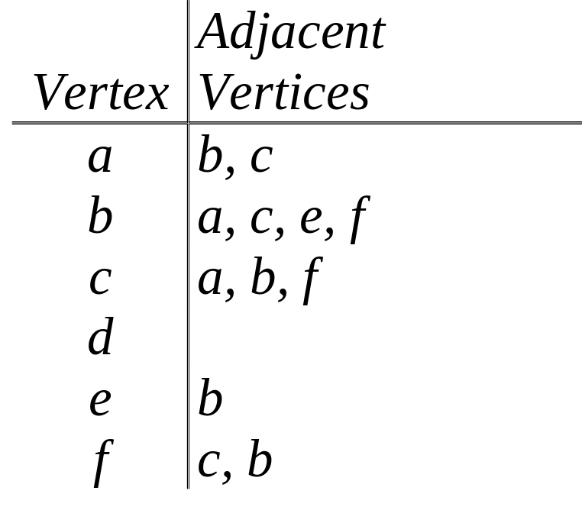
Adjacency Lists
A table with 1 row per vertex, listing its adjacent vertices.
a
b
c
d
e
f
School of Computer Science

Slide 3
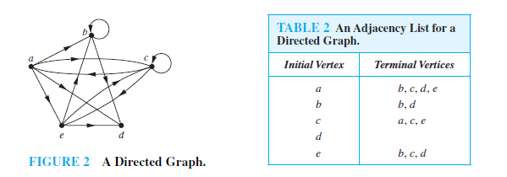
Directed Adjacency Lists
1 row per node, listing the terminal nodes of each edge incident from that node.
P703
School of Computer Science

Slide 4
Adjacency Matrices
A way to represent simple graphs
  possibly with self-loops.
Matrix A=[a_{ij}], where a_{ij} is 1 if {v_{i}, v_{j}} is an edge of G, and is 0 otherwise.
Can extend to pseudographs by letting each matrix elements be the number of links (possibly >1) between the nodes.
School of Computer Science

Slide 5
Note
An adjacency matrix of a graph is based on the ordering chosen for the vertices.
The adjacency matrix of a simple graph is symmetric.
a_{ii}=0
Sparse matrix( 稀疏矩阵)
School of Computer Science

Slide 6
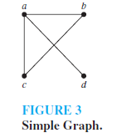
Example 3
Use an adjacency matrix to represent the graph shown in Figure 3.
School of Computer Science

Slide 7

Example 4
Draw a graph with the adjacency matrix
with respect to the ordering of vertices a, b, c, d.
School of Computer Science

Slide 8
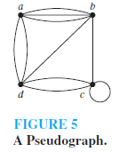
Example 5
Use an adjacency matrix to represent the pseudograph shown in Figure 5.
School of Computer Science

Slide 9

Adjacency matrix for a directed graph
Adjacency matrix for a directed multigraph
  such matrices are not zero–one matrices when there are multiple edges in the same direction connecting two vertices.
  a_{ij} equals the number of edges that are associated to (v_{i}, v_{j}).
School of Computer Science

Slide 10
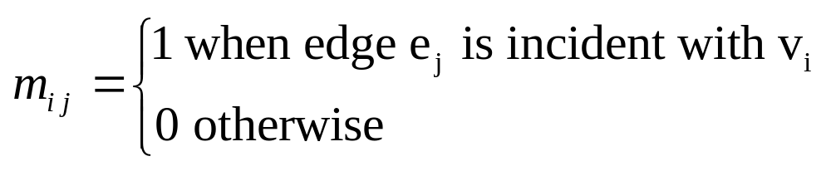
Incidence matrices
Let G=(V,E) be an undirected graph. Suppose that v₁,v₂,…,v_{n} are the vertices and e₁,e₂,…,e_{m} are the edges of G. Then the incidence matrix with respect to this ordering of V and E is the n*m matrix M=[m_{ij}], where
School of Computer Science

Slide 11
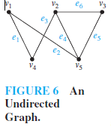
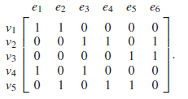
Example 6
Represent the graph shown in Figure 6 with an incidence matrix.
School of Computer Science

Slide 12
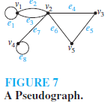
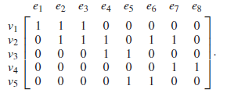
Example 7
Represent the pseudograph shown in Figure 7 using an incidence matrix.
School of Computer Science

Slide 13
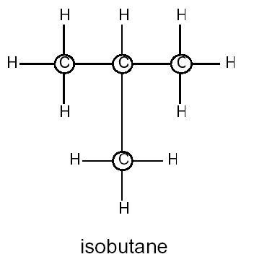
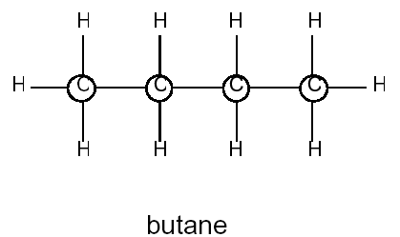
Graph Isomorphism
The Greek root “iso” means “same”. The Greek root “morphism” means “form”.
Two molecules with the same chemical formula are called isomers.
School of Computer Science

Slide 14
Graph Isomorphism
Formal definition:
  Simple graphs G₁=(V₁, E₁) and G₂=(V₂, E₂) are isomorphic iff ∃ a bijection f:V₁→V₂ such that ∀ a,b∈V₁, a and b are adjacent in G₁ iff f(a) and f(b) are adjacent in G₂.
  f is the “renaming” function between the two node sets that makes the two graphs identical.
  This definition can easily be extended to other types of graphs.
School of Computer Science

Slide 15
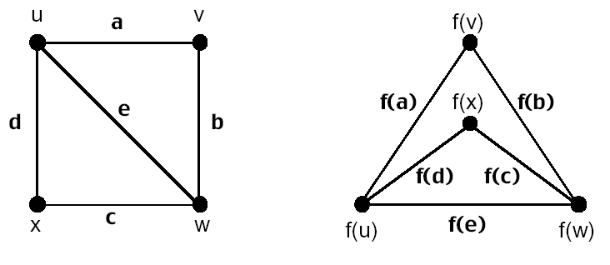
Example
The graph mapping f is an isomorphism.
School of Computer Science

Slide 16
Graph Invariants under Isomorphism
Necessary but not sufficient conditions for G₁=(V₁, E₁) to be isomorphic to G₂=(V₂, E₂):
  We must have that |V1|=|V2|, and |E1|=|E2|.
  The number of vertices with degree n is the same in both graphs.
  For every proper subgraph g of one graph, there is a proper subgraph of the other graph that is isomorphic to g.
School of Computer Science

Slide 17
Isomorphism Example
If isomorphic, label the 2nd graph to show the isomorphism, else identify difference.
d
b
a
b
a
d
c
e
e
c
f
f
School of Computer Science

Slide 18
Are These Isomorphic?
If isomorphic, label the 2nd graph to show the isomorphism, else identify difference.
Same # of vertices
a
b
Same # of edges
d
Different # of verts of degree 2!
(1 vs 3)
c
e
School of Computer Science

Slide 19

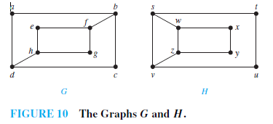
单选题
1分
Determine whether the graphs shown in Figure 10 are isomorphic.
A
YES
B
NO
提交
School of Computer Science

Slide 20
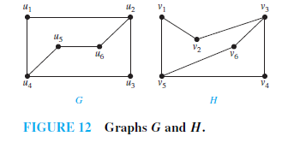
Example 11
Determine whether the graphs G and H displayed in Figure 12 are isomorphic.
School of Computer Science

Slide 21
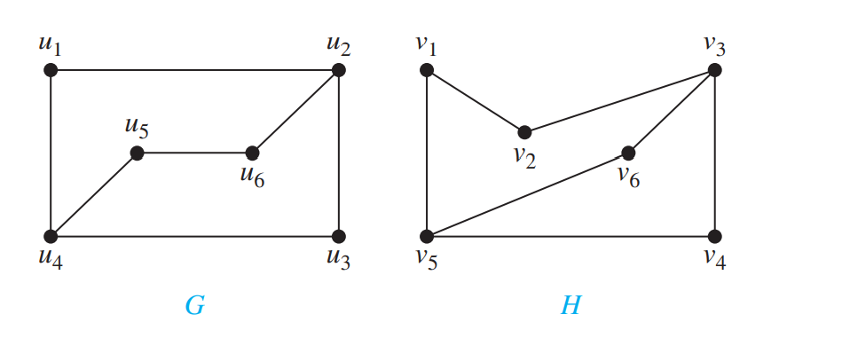
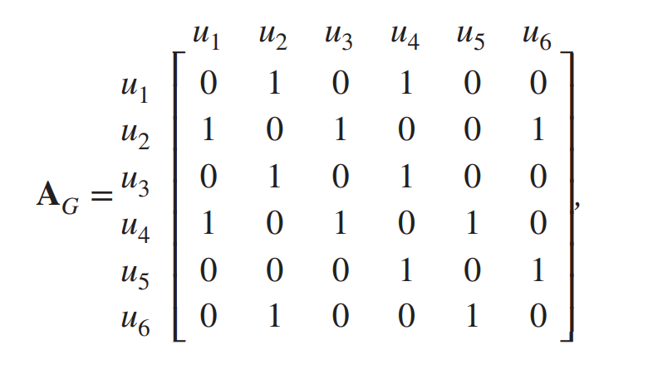
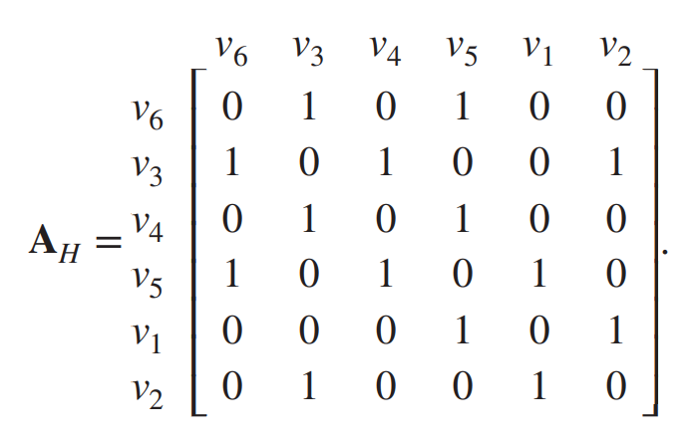
Example 11
School of Computer Science

Slide 22
Applications of Graph Isomorphisms
Chemistry
Design of electronic circuits
Bioinformatics
Computer vision.
School of Computer Science

Slide 23
Homework
§10.3
  32, 50, 56, 66, 74
School of Computer Science

